Slide 1

Intelligent Agents
Prepared by
Lec Shekh. Md. Saifur Rahman
PREPARED BY
SWAPNIL BISWAS

Slide 2
Agents
An agent is anything that can be viewed as perceiving its environment through sensors and acting upon that environment through actuators Human Agent: eyes, ears, and other organs for sensors; hands, legs, mouth, and other body parts for actuators Robotic Agent: cameras and infrared range finders for sensors; various motors for actuators;

Slide 3
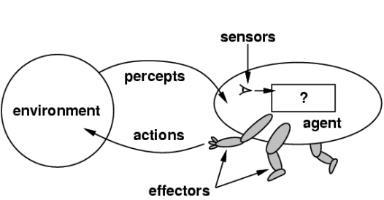
How to design an intelligent agent?
An intelligent agent perceives its environment via sensors and acts rationally upon that environment with its effectors.
A discrete agent receives percepts one at a time, and maps this percept sequence to a sequence of discrete actions.
Properties:
Autonomous
Reactive to the environment
Pro-active (goal-directed)
Interacts with other agents via the environment

Slide 4
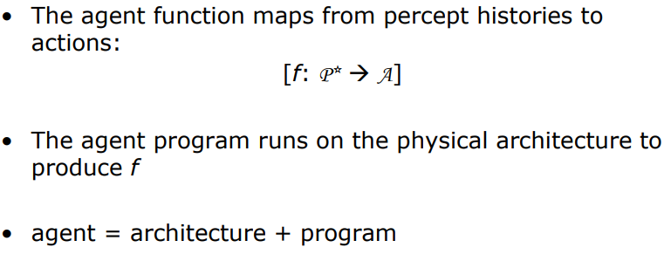
Agents and environments

Slide 5
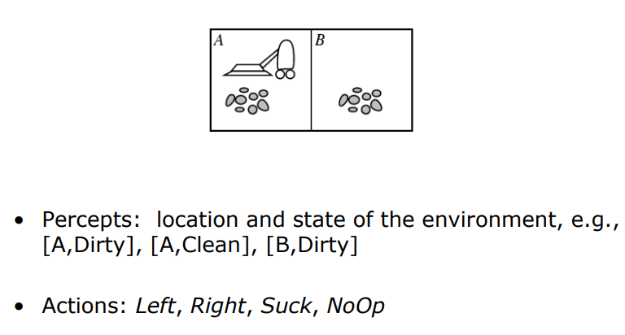
Vacuum-cleaner world

Slide 6
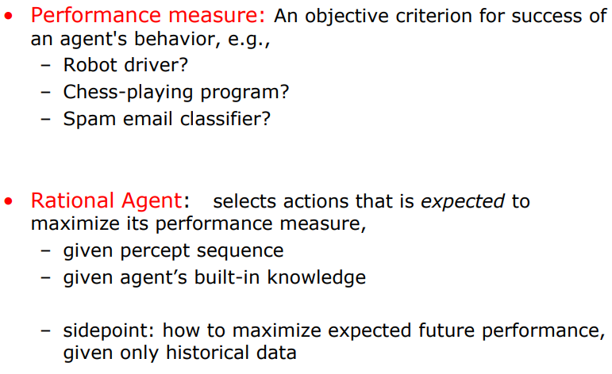
Rational agents

Slide 7
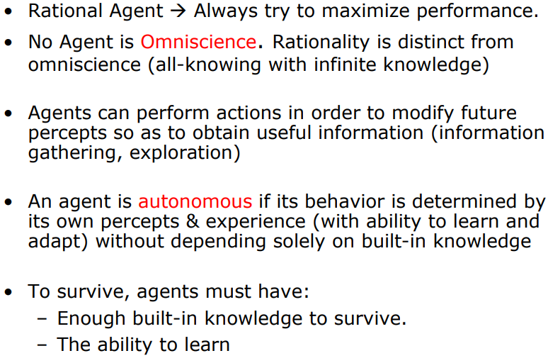
Rational agents

Slide 8
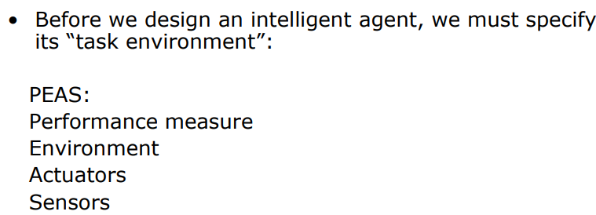
Task Environment

Slide 9
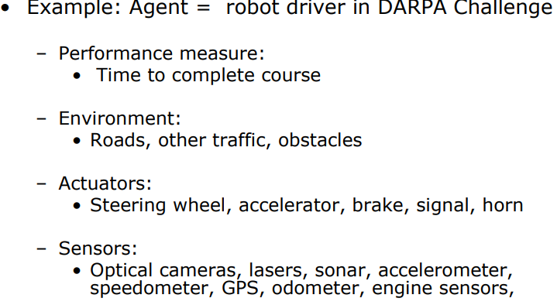
PEAS

Slide 10
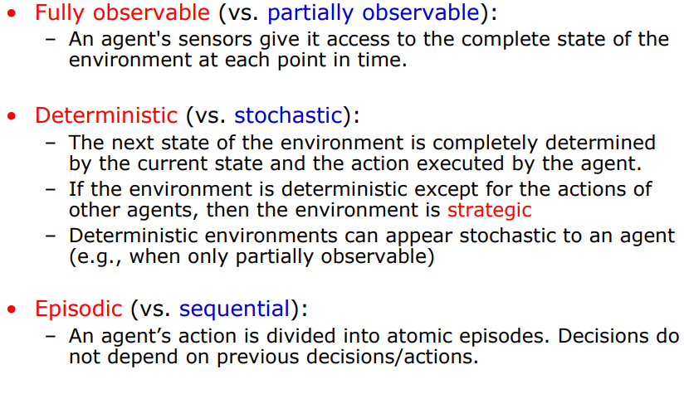
Environment types

Slide 11
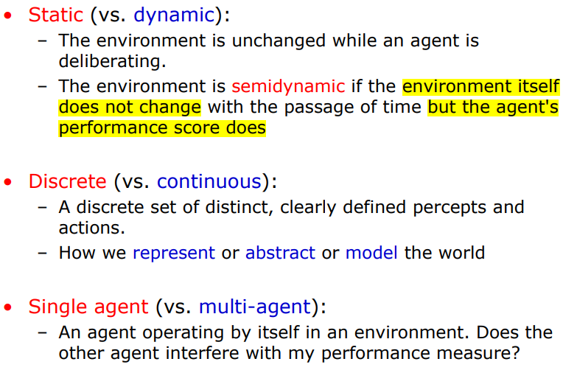
Environment types

Slide 12
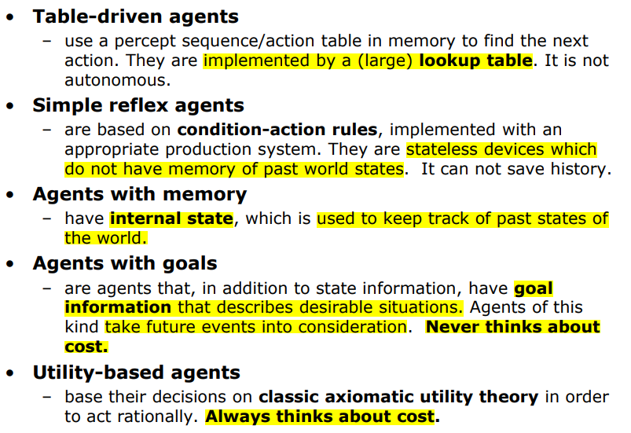
Some agent types

Slide 13
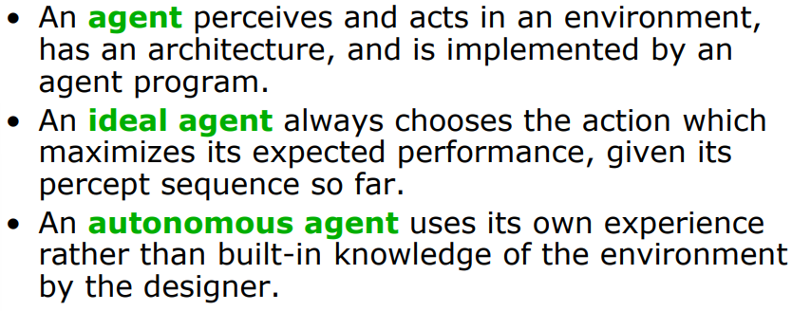
Summary

